Slide 1
Ontology of biomedical investigations (OBI)
Bjoern Peters La Jolla Institute for Allergy and Immunology Feb 15th

Slide 2
OBI Timeline
MO/ MAGE
FuGO
FuGE
OBI
2004 2005 2006 2007
MAGE
Jamboree
Hinxton
Dec
1st FuGO
Workshop
Philadelphia
Feb.
2nd FuGO
Workshop
Hinxton
July
OBI Workshop San Diego Jan.
SOFG
Philadelphia
Oct
MAGE
Jamboree
Stanford
March
MGED 8
Bergen
Sept.
Transcriptomics (MGED)
Proteomics (PSI)
PSI
Siena
April
Cancer Genomics
Polypmorphisms
Genome Sequences
Crop Sciences
Toxicogenomics
Environmental Genomics
Nutrigenomics
(MGED RSBI)
Metabolomics
Flow Cytometry
Cellular Assays Immport IEDB Neuroinformatics
From Jan, 2007 OBI workshop in LIAI

Slide 3
OBI Timeline
Philly 2009 release
Vancouver 2010
San Diego 2011
2007 2008 2009 2010 2011
Workshops: Bethesda Vancouver EBI EBI Philly Vancouver San Diego
Foundry review
DENRIE -> IAO
OBO Foundry
MIREOT
J Biomed Sem.
Bio-imaging,
Clinical Investigations,
Electrophysiology,
Structural Biology
Robot
Scientists
Vaccines
Eagle-i

Slide 4
2011 Principles – 2009 review
FP01 open: Yes
FP02 format: OWL
FP03 identifiers: names and identifiers are unique
FP04 versioning: dc:date, owl:versioninfo. 3 stable releases since 2009
FP05 delineated content : clearly delineated. (later slide)
FP06 textual definitions : completeness is high. (Now required for release)
FP07 relations: RO /ro_proposed used where appropriate. (later slide)
FP08 documentation: 1 Paper on OBI + 3 on design principles. Wiki manuals
FP09 users: TBD. (later slide)
FP10 collaboration: YES (gold star)
FP11 locus of authority: Yes
FP12 naming conventions: being followed during development
FP16 maintenance: constant updates (e.g. sequencing techniques)

Slide 5
FP05 delineated content
Ontology of biomedical investigations.
Processes, materials, information and specifically dependent continuants that would not exist without humans intervention and that are necessary to describe investigation
Extensive use of cross referencing to OBO ontologies. OBI developed MIREOT principle to allow this.
We would be very happy to move out e.g. immunological terms that currently have no natural home
We would be fine with moving out things that are not essential to investigation (organizations, software, information, cell lines)
We expect that OBO foundry ontologies on anything specific to investigations (assays, instruments, data analysis pipelines, making cell lines) is performed under the OBI umbrella

Slide 6
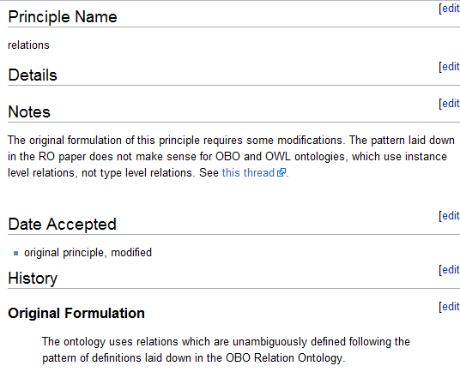
FP07 - relations
http://www.obofoundry.org/wiki/index.php/FP_007_relations
Unclear if there is a principle
We are using RO relations, subclassing them, submitting proposals for new relations back

Slide 7
FP09 users
Who is going to be our independent users, if we force everyone to contribute?
Ryan Brinkman, Bill Bug, Kevin Clancy, Mélanie Courtot, Dirk Derom, Liju Fan, Dawn Field, Jennifer Fostel, Gilberto Fragoso, Frank Gibson, Yongqun He, Tina Hernandez-Boussard, Phillip Lord, Allyson L. Lister, James Malone, Monnie McGee, Elisabetta Manduchi, Norman Morrison, Helen Parkinson, Bjoern Peters, Philippe Rocca-Serra, Alan Ruttenberg, Susanna-Assunta Sansone, Richard H. Scheuermann, Daniel Schober, Barry Smith, Larisa N. Soldatova, Christian J. Stoeckert Jr., Chris F Taylor, Patricia L. Whetzel, Jie Zheng, Jessica Turner, Melissa Haendel, Marcus Chibucos, Carlos Torniai, Anita Bandrowski, Fahim Imam (authors on release paper + last workshop attendees)

Slide 8
User metrics
Google scholar: OBI ontology biomedical investigations = 414 journal articles
Bioportal: X communities use OBI.owl

Slide 9
18 projects currently using OBI

Slide 10
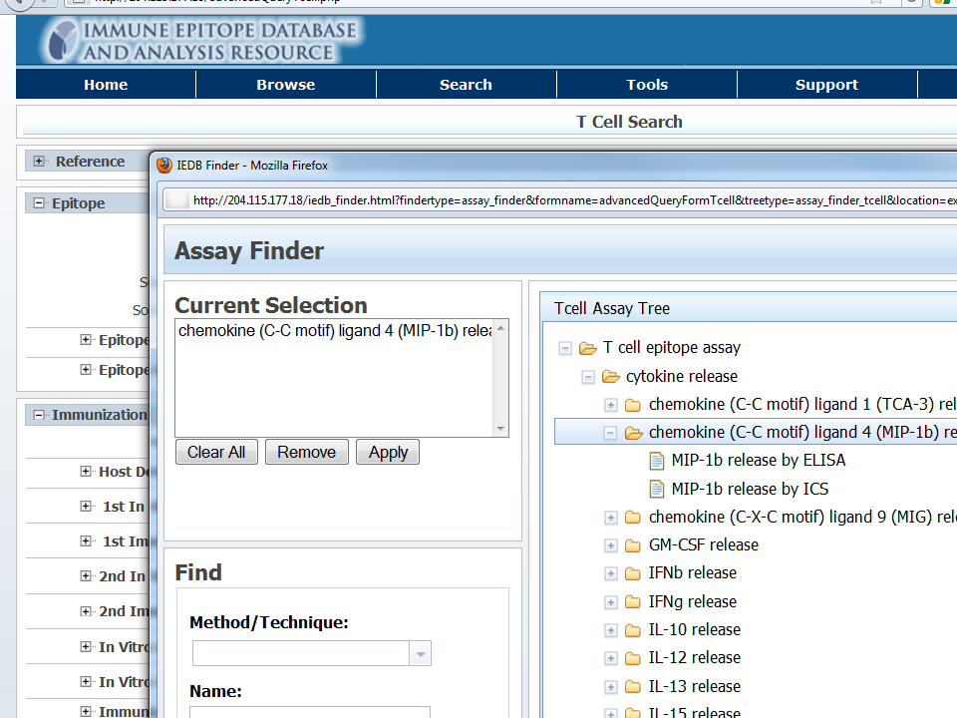
OBI classes and IDs used on the web

Slide 11
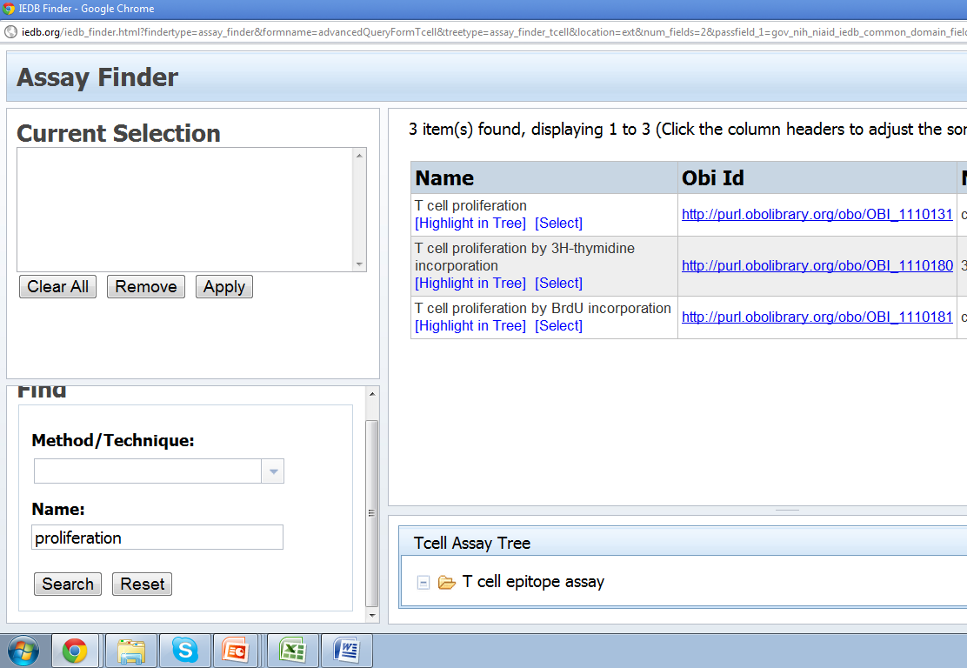

Slide 12
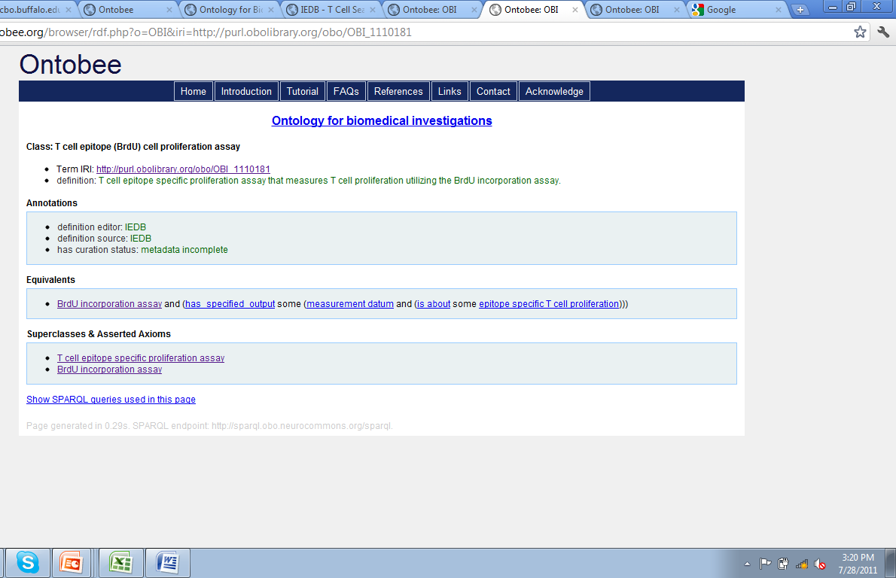

Slide 13
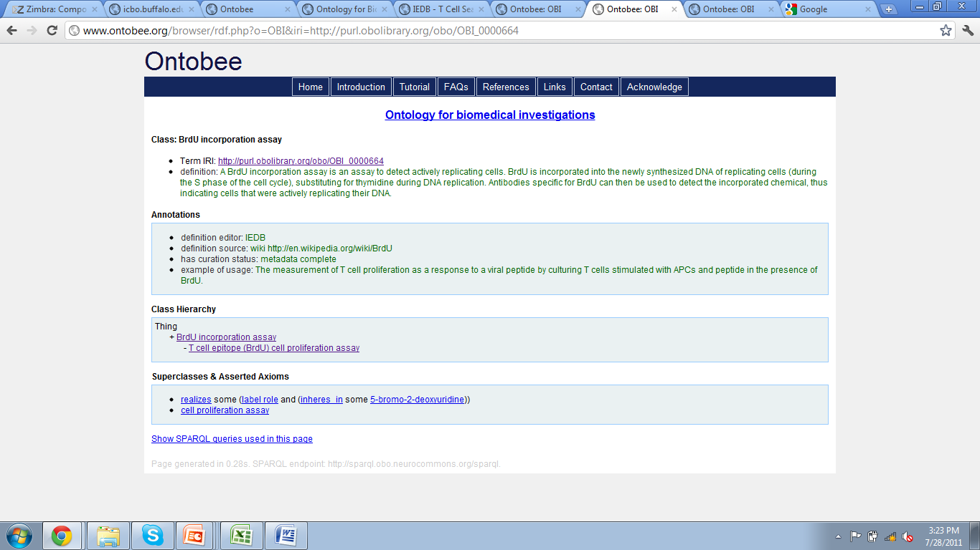

Slide 14
Thanks!

Slide 15
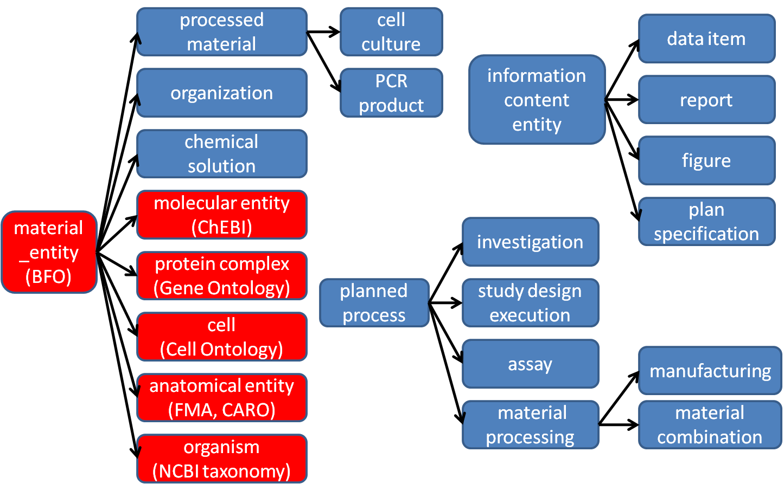
High level class hierarchy (partial)
IAO
Notes:
Remove planning

Slide 16
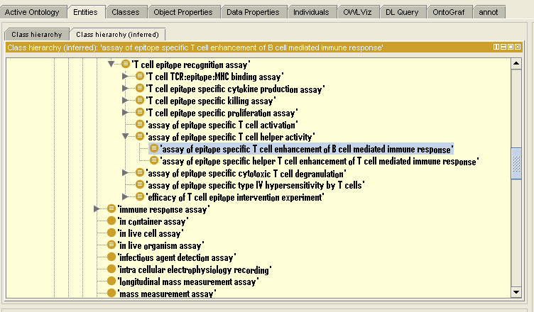
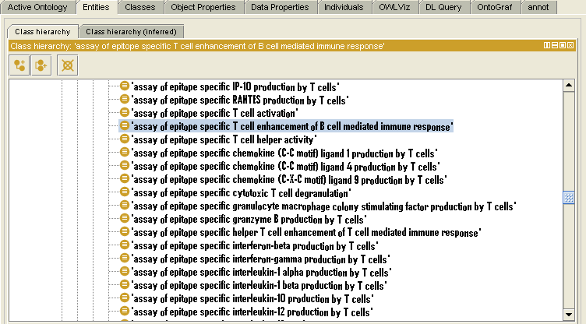
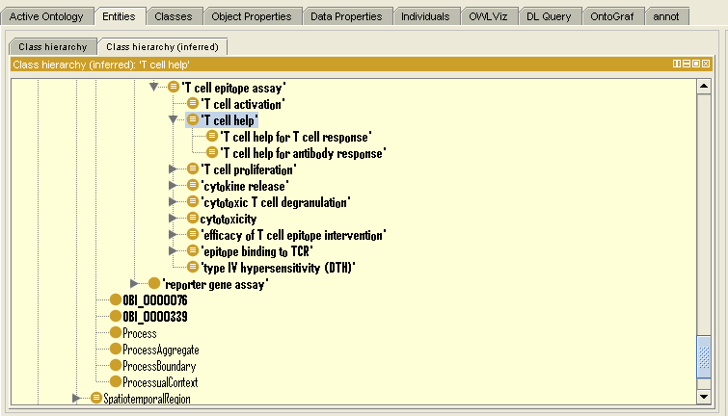
Reasoning introduces hierarchy
Display with community specific “IEDB alternative label”

Slide 17
Foundry review 2009
Feedback 1 (implicit): Need to demonstrate users (FP09)
Feedback 2: (stylicstic) Overly complex modeling

Slide 18
Progress since last year
Focused OBI development on selected use cases
Model individual experiments from diverse backgrounds (Vaccine protection, Neuroscience, Automated functional genomics)
Create data analysis workflows (Genepattern)
Query databases (IEDB)
Model sample use case of clinical investigation from planning to publication
Release of OBI ‘Release candidate 1.0’ (Philly release)
Major cleanup of all terms
Submitted manuscript to Nature Biotechnology
Overall positive reviews
Main critique: ‘Demonstrate in a broadly applicable manner what we can do with OBI that we could not do before’

Slide 19
Acted on foundry review
Main concern: overly complex modeling
To address this, we
Reduced our ambition what level of detail we want to express in OWL
Introduced shortcut relations (e.g. ‘p achieves planned objective o’ rather than ‘p realizes some (is_concretization_of o)’
Aim to reduce anonymous class expressions in logical definitions (requires asserting under classes with N&S conditions)
Focus on developing design patterns
But: complexity won’t go away completely

Slide 20
Integration with other ontologies
Apologies for any oversights:
Imports from Caro, ChEBI, CL, FMA, GO, HP, IAO, NCBI Taxonomy, PATO, PRO, RO, SO, UO, VO
Term requests send to ChEBI, GO, IAO, IDO, PATO, PRO, RO.
This works! Thanks!

Slide 21
Examples
Use of GO ‘assay detecting IFN-gamma production’ assay and has specified output some measurement datum and is about some IFN-gamma production (GO:0032609)
Inferred subclasses:
‘T cell ELISA IFN-gamma assay’
‘T cell intracellular cytokine staining IFN-gamma assay’
Use of ChEBI:
‘tritiated thymidine incorporation assay’
realizes some label role and inheres in some tritiated thymidine (CHEBI:53526)

Slide 22
Future Plans
Continue development for currently driving projects (e.g. mapping of MGED Ontology into OBI, influenza research database & network, text mining)
Expand to projects that expressed interest (e.g. BIRN/NIF, RNAO, eagle-I)
Develop processes and tools to enable large scale term submissions / ontology integration

Slide 23
Foundry requests / concerns
What are the OBO Foundry principles? These http://obofoundry.org/crit.shtml or these http://obofoundry.org/wiki/index.php/OBO_Foundry_Principles
A clear distinction of what it means to be a member of the OBO library a candidate and the OBO Foundry should be made more explicit on the foundry site.
What does OBI have to do to gain foundry status? ANSWER: Demonstrate independent users.
What is the foundry decision making structure; who is responsible for what? (a formal, transparent process would be great!)

Slide 24
Foundry requests / concerns
State of BF0-2.0 and relations
Will there be public call for comments on a draft version (if yes, when?)
What is the status of OBI relations submitted to RO?
Will BFO be registered in the OBO Foundry (and subject to the same review criteria)?
It can be problematic to integrate with other resources that adopt BFO. Is there any plan to help to increase adoption rate?

Slide 25
Foundry requests / concerns
Has there been any progress on inter-species anatomy, and/or any way we could help?
Can people share success stories, demonstrating the usefulness of ontology work in general? (This would help addressing criticism we received for OBI paper). Most interest in newer, and cross-foundry efforts (not: GO).

Slide 26
Thanks!
Next workshop: March 22-25, Vancouver, Canada
http://obi-ontology.org/
Ryan Brinkman, Bill Bug, Kevin Clancy, Mélanie Courtot, Dirk Derom, Liju Fan, Dawn Field, Jennifer Fostel, Gilberto Fragoso, Frank Gibson, Yongqun He, Tina Hernandez-Boussard, Phillip Lord, Allyson L. Lister, James Malone, Monnie McGee, Elisabetta Manduchi, Norman Morrison, Helen Parkinson, Bjoern Peters, Philippe Rocca-Serra, Alan Ruttenberg, Susanna-Assunta Sansone, Richard H. Scheuermann, Daniel Schober, Barry Smith, Larisa N. Soldatova, Christian J. Stoeckert Jr., Chris F Taylor, Patricia L. Whetzel and Jie Zheng
Who is going to be our independent users, if we force everyone to contribute?

